Slide 1
Nuclear Fuel Performance
NE 533 Spring 2023

Slide 2
Last Time
Finished fuel/reactor type overview
All reactors have basic requirements they must meet
An approach to remove the heat from the fuel
A method to convert heat to electricity
An approach to prevent radioactive products from leaving the fuel
A method to cycle the fuel
Containment in case something goes very wrong
LWRs have a certain way of meeting these requirements, but there are other options

Slide 3
Reactor systems

Slide 4
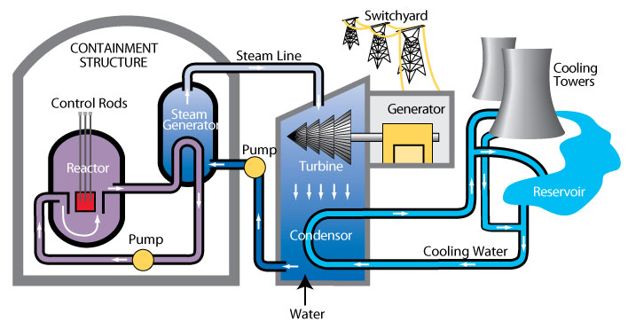
Heat removal systems
Now we touch on how heat is removed from the fuel
Primary mechanism to remove heat directly from fuel is a coolant
Various coolant types, most common is water

Slide 5
Heat removal systems
Primary loop water runs through the core, transporting heat generated by the fuel, to a steam generator in a secondary water loop
Steam drives a turbine, generating electricity
A tertiary water loop helps to condense residual steam from the secondary loop via cooling towers and a water reservoir

Slide 6
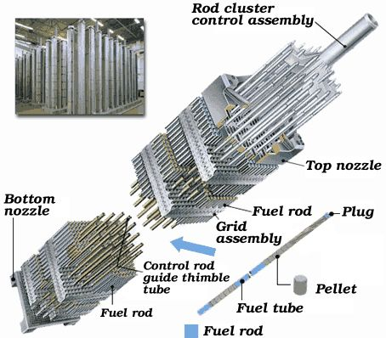
Light Water Reactor Core Design
An LWR core is comprised of fuel assemblies
Each assembly contains a grid of fuel pins
In typical commercial LWR fuel designs, a 17x17 grid
Some pins are replaced by control rods
Water flows from bottom to top

Slide 7
LWR Fuel Pins
LWR fuel pins are comprised of a hollow Zircaloy tube
This is the cladding
Zircaloy is a type of Zr alloy
Inside the cladding are stacked UO2 pellets
Each pellet is a cylinder about 1 cm in diameter and 1 cm in height

Slide 8
Not only water-cooled reactor designs

Slide 9
Not all fuel is pellet-based
Metallic fuel is a solid fuel slug
Utilized an Fe-based cladding, such as HT-9 or SS
TRISO particles are formed into spherical compacts, or can be formed into pellet compacts
UMo and USi have been used in plate fuels
Assemblies are often hex-shaped and can included reflectors

Slide 10
ATR and HFIR Core design
HFIR combines curved plates in concentric regions
The ATR core is a unique curved design with plate type fuel

Slide 11
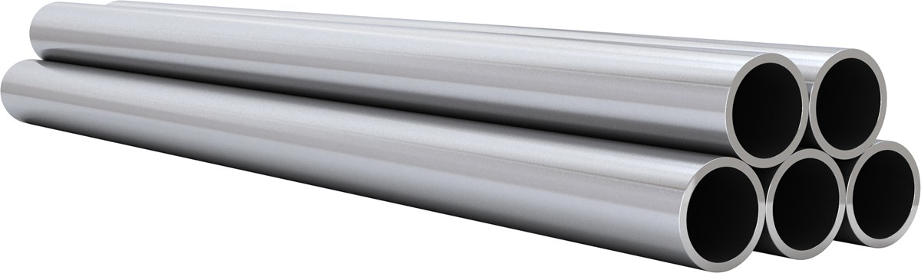
Most fuel designs employ some type of cladding
The primary focus of the cladding is to separate the fuel from the coolant
Fuel contains radioactive fission products
Avoids corrosion of the fuel by the coolant
Keeps the fuel together, not blocking coolant flow
The cladding should be thin and have a high thermal conductivity, so it doesn’t trap any of the heat produced by the fuel
Cladding should also be neutron transparent

Slide 12
Fuel/Cladding Gap
Fuel swells during reactor operation and the cladding creeps down around the fuel
To avoid/limit both chemical and mechanical interaction, the pellet radius is smaller that the inner radius of the cladding
In LWRs, the gap is filled with gas, significantly impacting the heat transport
In metal fuels, the gap is filled with liquid sodium, so there is little impact on the heat transport

Slide 13
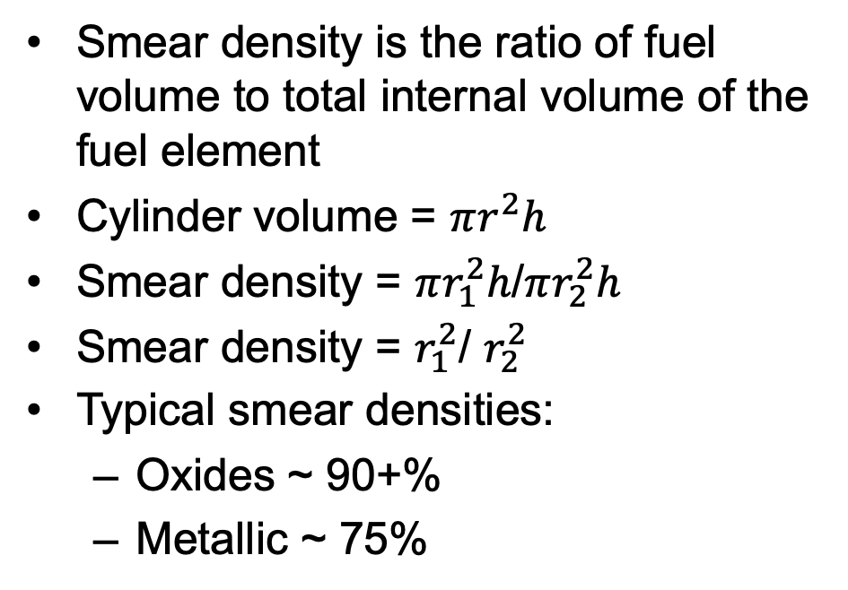
Smear Density
Smear density is the ratio of fuel volume to total internal volume of the fuel element
Cylinder volume = $πr^{2}h$
Smear density = $πr_{1}^{2}h$/$πr_{2}^{2}h$
Smear density = $r_{1}^{2}$/ $r_{2}^{2}$
Typical smear densities:
Oxides ~ 90+%
Metallic ~ 75%
r1
H
r2

Slide 14
Cladding material selection
Cladding must be compatible with the coolant, reasonably compatible with the fuel, have good thermal conductivity and reasonable radiation resistance
Zirconium is used because of its
Low neutron cross section
Corrosion resistance in 300 C water
Resistance to void swelling
Adequate mechanical properties
Good thermal conductivity
Affordable cost
Available in large quantities
Other cladding materials in use include
Stainless steel
Silicon Carbide
Ferritic-Martensitic steels like Fe-Cr and Fe-Cr-Al
Oxide dispersion strengthened (ODS) ferritic steels

Slide 15
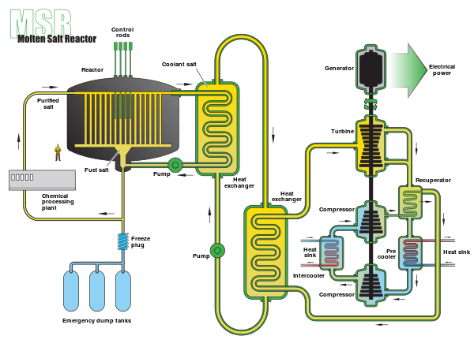
Molten Salt Reactors w/o cladding
Some MSRs plan to utilize liquid molten salts as the fuel, flowing continuously through the core
Secondary loop comprised of coolant salt, such as FLiBe
Example was the MSRE from ORNL, which utilized LiF-BeF2-ZrF4-UF4 as the fuel
Cladding is the flow piping

Slide 16
fuel fabrication

Slide 17
Fabrication Process

Slide 18
Uranium deposit types
There are mainly three types of uranium deposits
Sedimentary
Often found in sandstone; common in Canada and western US
Igneous/hydrothermal
Vein-type uranium ores from geothermal activity; Greenland and Namibia
Breccial
found in rocks that have been broken due to tectonic fracturing, or weathering; common in India, Australia and the US
Less common means of uranium mining include seawater recovery, where U concentrations is 3.3 micrograms per liter

Slide 19
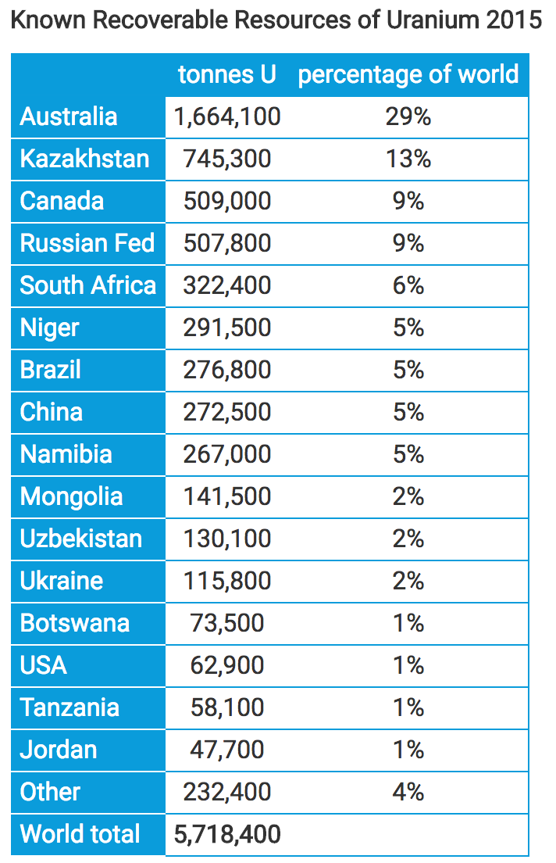
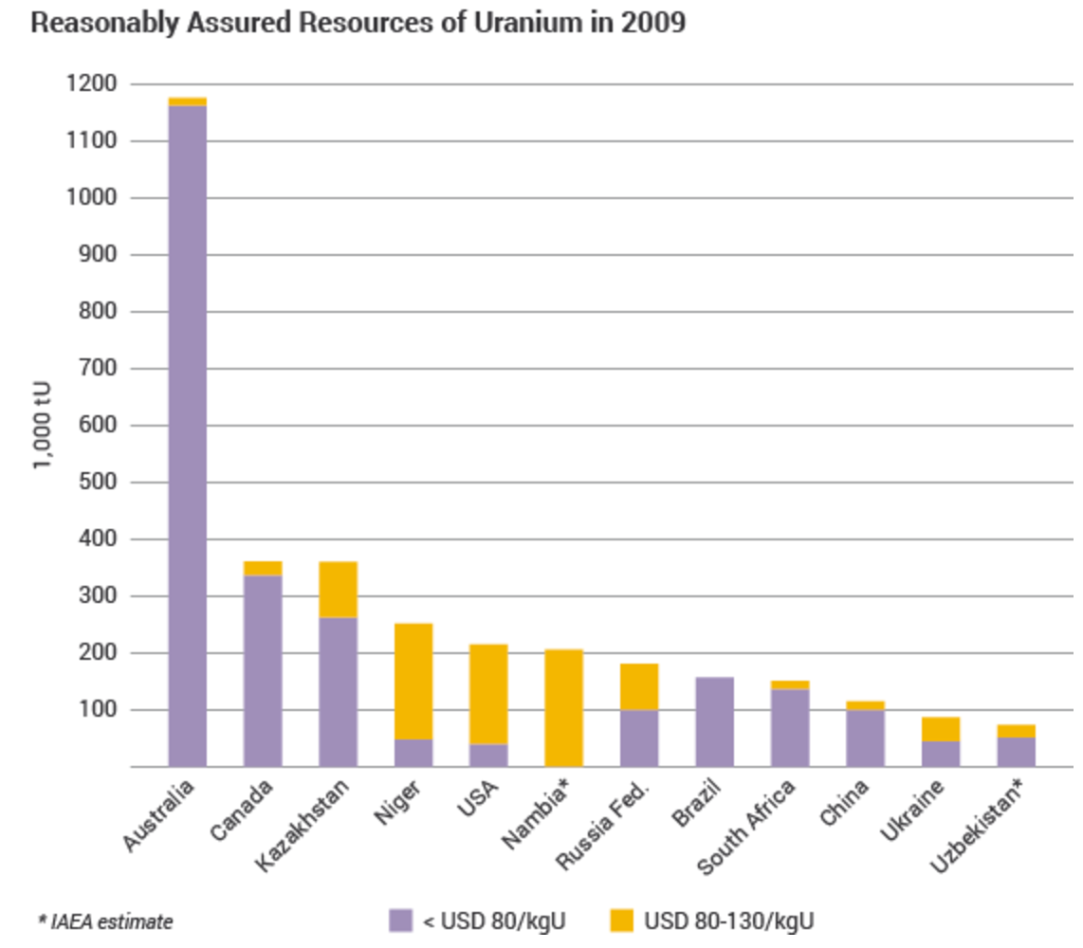
Global Uranium Resources

Slide 20
Uranium mining/processing
Uranium ores are normally processed by grinding the ore materials to a uniform particle size and then treating the ore to extract the uranium by chemical leaching
The milling process commonly yields dry powder-form material consisting of “yellowcake”, which is U₃O₈

Slide 21
Conversion
Uranium enrichment requires uranium as uranium hexafluoride, which is obtained from converting uranium oxide to UF₆
Uranium oxide can be reduced by hydrogen to produce UO2
U₃O₈ + 2H₂ ===> 3UO₂ + 2H₂O
The oxide is then reacted with hydrogen fluoride to form uranium tetrafluoride (UF4)
UO₂ + 4HF ===> UF₄ + 2H₂O
The tetrafluoride is then fed into a fluidized bed reactor with gaseous fluorine to produce uranium hexafluoride, UF6
UF₄ + F₂ ===> UF₆

Slide 22
Enrichment
Natural uranium only contains 0.7% U-235, and therefore must be enriched to obtain suitable fissile material for fuel (for most reactors)
The difference in mass between U-235 and U-238 allows the isotopes to be separated and makes it possible to enrich the percentage of U-235
The capacity of enrichment plants is measured in terms of 'separative work units' or SWU
Two main enrichment processes
Gaseous diffusion: 2500 kWh per SWU
Centrifuge: 50 kWh per SWU

Slide 23
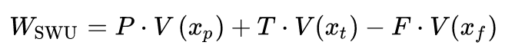
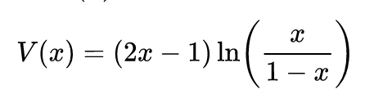
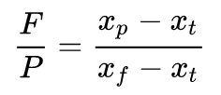
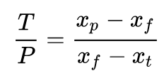
SWUs
The work W_{SWU} necessary to separate a mass F of feed of assay x_{f} into a mass P of product assay xp and tails of mass T and assay x_{t} is given by:
V is the value function:
The feed to product ratio is given by the expression
The tails to product ratio is given by the expression
The same amount of separative work will require different
amounts of energy depending on the efficiency of the separation technology

Slide 24
Enrichment
Gaseous diffusion
Pushes UF6 through porous membrane
U235-F6 travels slightly faster
First Gen. technology, historical, but now outdated
Centrifuge
gas is placed in a gas centrifuge cylinder and rotated at a high speed
strong centrifugal force, heavier gas molecules move towards the outside of the cylinder

Slide 25
Enrichment
One ton of natural uranium feedstock might end up: as 120-130 kg of uranium for power reactor fuel, as 26 kg of typical research reactor fuel, or conceivably as 5.6 kg of weapons-grade material
The curve flattens out so much because the mass of material being enriched progressively diminishes, so requires less effort relative to what has already been applied to progress a lot further in percentage enrichment

Slide 26
Enrichment
Enrichment accounts for almost half of the cost of nuclear fuel and about 5% of the total cost of the electricity generated
It is also the main greenhouse gas impact from the nuclear fuel cycle where the electricity used for enrichment is typically generated from coal or natural gas
However, it still only amounts to 0.1% of the carbon dioxide from equivalent coal-fired electricity generation if modern gas centrifuge plants are used

Slide 27
Fabrication Process

Slide 28
Powder Processing
Uranium typically arrives at a fuel manufacturing plant as uranium hexafluoride (UF₆) and needs to be converted to uranium dioxide (UO₂) prior to pellet fabrication
An example conversion process injects UF₆ into water to form a UO₂F₂ particulate slurry, ammonia (NH3) is added to this mixture and the UO₂F₂ reacts to produce ammonium diuranate (ADU, (NH₃)2U₂O₇), after which the slurry is filtered, dried and heated in a reducing atmosphere to pure UO₂
A reducing atmosphere is one in which oxidation is prevented by removal of oxygen and other oxidizing gases, and which may contain actively reducing gases such as hydrogen

Slide 29
Powder/Pellet Processing
The UO₂ powder may need further processing or conditioning before it can be formed into pellets:
Homogenization: powders may need to be blended to ensure uniformity in terms of particle size distribution and specific surface area
Additives: U₃O₈ may be added to ensure satisfactory microstructure and density for the pellets and other fuel ingredients, such as lubricants, burnable absorbers (e.g., gadolinium) and pore-formers may also need to be added
UO₂ powder is fed into dies and pressed biaxially into cylindrical pellet form using a load of several hundred MPa
Pellets are then sintered in a heating furnace
Sintering is the process of compacting and forming a solid mass of material by heat or pressure

Slide 30
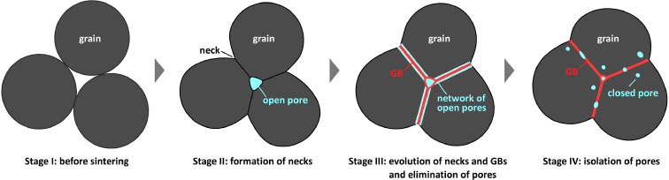
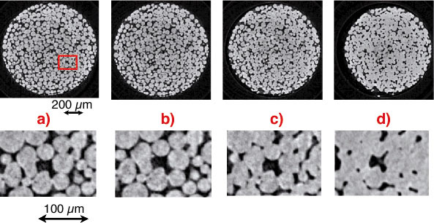
Sintering Process
During sintering, atoms in the materials diffuse across the boundaries of the particles, fusing the particles together and creating one solid piece
The final fuel pellets are nearly fully dense with a uniform microstructure: grain size ~ 10 μm; pore size ~ 3 μm; density ~ 95 - 99%
A single pellet in a typical reactor yields about the same amount of energy as one ton of coal

Slide 31
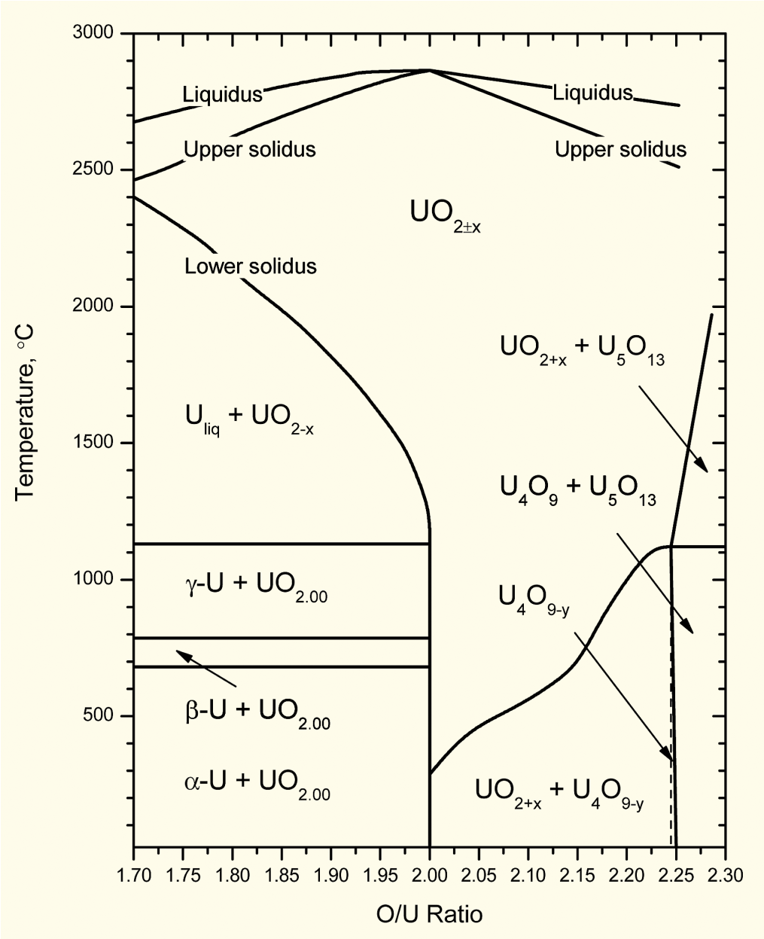
Fuel strictly manufactured to be UO₂
Fuel fabricated to be nearly stoichiometric; i.e., UO_{2.00±}
Structure stable to T_{melt}
Maximum T_{melt}
O/M ratio varies slightly during irradiation
Large deviations from stoichiometry relevant to
Fabrication
Defected fuel behavior
Reprocessing
Accident conditions during dry storage or shipment of used nuclear fuel

Slide 32
Rods and Assemblies
The fuel pellets are assembled in fuel rods and then put together in fuel assemblies
Designs dictate that the pellet-filled rods have a precise physical arrangement in terms of their lattice pitch (spacing), and their relation to other features such as water (moderator) channels and control-rod channels
Physical structures for holding the fuel rods are therefore engineered with extremely tight tolerances and are largely constructed of steel and zirconium alloys

Slide 33
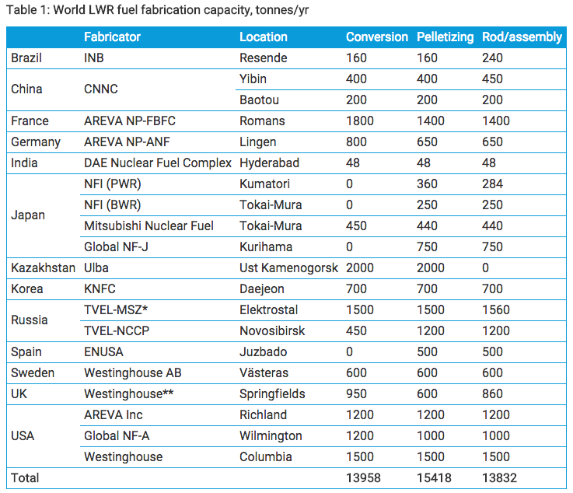
Global Fuel Fabrication
Uranium is mined and converted into fuel in a number of countries
USA, Russia, Kazakhstan and France are leaders
There is a growing need for HALEU
High assay low enriched uranium
Uranium with 19.7% enrichment

Slide 34
Fuel Fabrication Summary
Mining -> Processing -> Conversion -> Enrichment -> Powder -> Compaction/Sintering -> Rod/Assembly
U₃O₈ must be converted to UF₆ for enrichment, which is then converted to UO₂ powder for pellet manufacture
For different fuel types, enriched UF₆ follows a different path

Slide 35
Heat Generation

Slide 36
Fission basics
Impinging neutron of a given energy
Neutron energy determines cross section which determines probability of fission event
Neutron + Target Nucleus -> Two fission products, 2-3 neutrons
Fission releases around 210 MeV of energy
170 MeV to fission fragments
2 MeV per neutron
7 MeV gamma rays
Balance radioactive decay

Slide 37
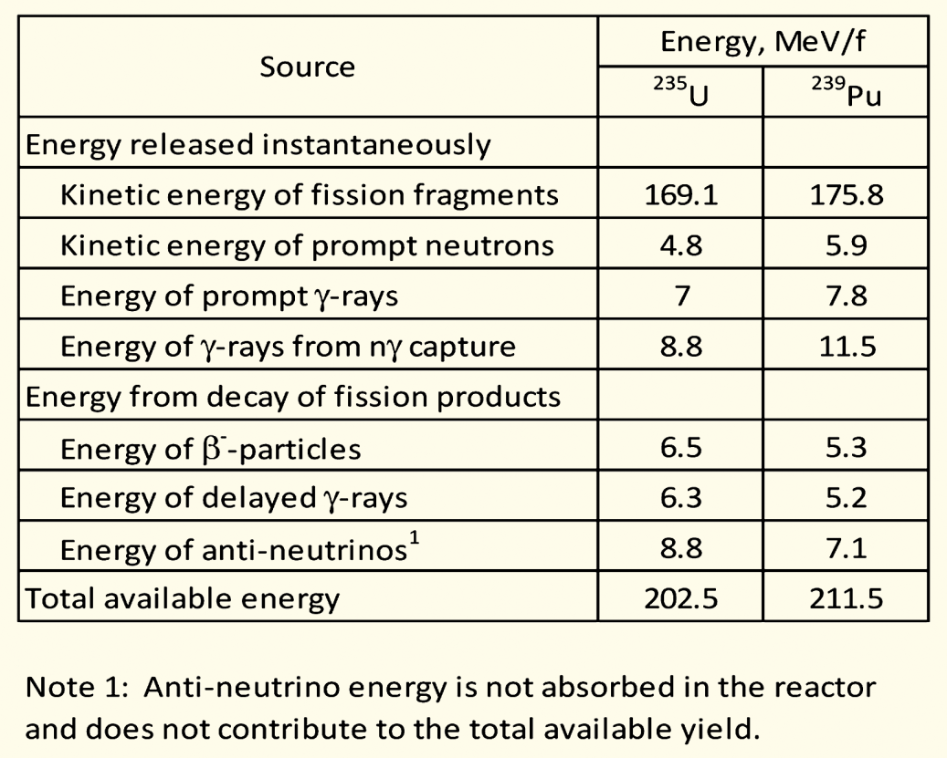
Energy release with different nuclei
Energy release is effectively agnostic with regards to the fissioning species
Comparing U-235 with Pu-239 on the right
Pu releases about 9 MeV more usable energy per fission
Less than a 5% difference
Partition of energy is largely identical as well

Slide 38
Fission product yield
Regardless of fissioning isotope, fission product yields are effectively the same, in this double hump distribution
One broad peak centered around A=95, the other around A=135
Examples:
Mo (Z=42, A=96)
Cs (Z=55, A=133)

Slide 39
Fission Product Yields

Slide 40
Calculating heat generation rate for a given fuel
We know about 200 MeV of energy is available due to a fission (210 MeV minus neutrinos)
We know the fission cross section of the target nuclide (tabulated)
We can calculate the fission atom density
The heat generation rate, Q is given by:
Q = E_{f} x N_{f} x σ_{f} x φ
Where E_{f} is the fission energy, N_{f} is the fission atom density, σ_{f} is the fission cross section, and φ is the neutron flux
Units: J/fission x atoms/cm³ x (fission/neutron)*(cm²/atom) x (neutron/cm²-s) = J/cm³-s = W/cm³

Slide 41
Calculating heat generation rate for a given fuel
Cross sections:
ENDF database: Nuclear Data Sheets 148 (2018) 1–142
Thermal neutron (E=0.025 eV) U235 fission cross section: 586.8 barns
1 barn = 10⁻²⁴ cm²
Fission atom density
Atom density of U-235 = UO2 density x 1/molar mass x Avogadro's number x atom fraction x enrichment

Slide 42
Calculating heat generation rate for a given fuel
Given a density of UO2 (10.97 g/cm³)
Enrichment of 3%
Molar mass of 3% enriched UO2
235*0.03 + 238*0.97 + 2*16 = 269.9 g/mol
Atom density of U-235 = 10.97 x 1/269.9 x 6.022E23 x 1/1 x 0.03
7.34E20 atoms/cm³
Given a flux of 5E13 neutrons/cm²/s
Q = E_{f} x N_{f} x σ_{f} x φ
200E6 eV x 1.602E-19 J/eV x 7.34E20 atoms/cc x 587E-24 cm² x 5E13 n/cm²/s
Q = 690 J/s/cm³ = 690 W/cm³

Slide 43
Some notes
Fast neutron cross section ~100x less than thermal neutron cross section
Fuels for fast neutron spectrum typically have high enrichments, 19.7% U-235
Historical research reactor fuels, such as UMo and USi, have had an enrichment of 90+%
Neutron flux will vary depending on the reactor
HFIR has a peak neutron flux of 3E15 n/cm²/s
PULSTAR has a peak neutron flux of 1E13 n/cm²/s
Significant variability in heat generation depending on fuel type and reactor conditions

Slide 44
heat transport

Slide 45
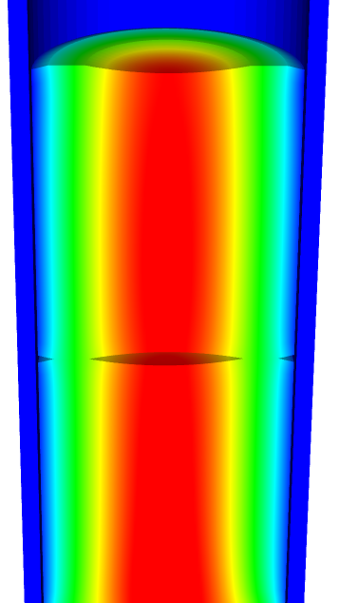
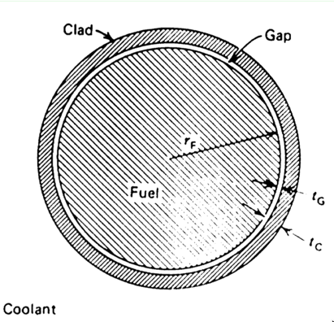
Heat transport route
Heat is produced in the fuel, transports through the cladding and gap, and into the coolant
Important quantities include
Volumetric heat generation rate Q (W/cm³)
Fuel Centerline temperature T₀
Surface temperature of the fuel T_{F}
Inner cladding temperature T_{CI}
Outer cladding temperature T_{CO}
Coolant temperature T_{cool}
Fuel pellet radius r_{F}
Gap thickness t_{G}
Cladding thickness t_{c}

Slide 46
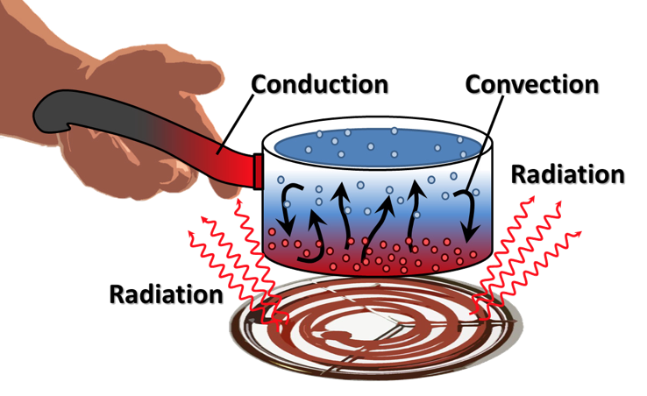
Heat can be transported in three ways
Convection
Heat transfer through mass movement of liquid or gas
Radiation
Heat transfer by means of photons in electromagnetic waves
Conduction
Heat transfer by molecular or atomic motion

Slide 47
Heat transfer mode in fuel systems?
How is heat transported through the fuel?
Conduction
How is the heat transported through the gap?
Mostly conduction, some convection
How is heat transported through the cladding?
Conduction
How is heat transported to the coolant?
Convection

Slide 48
Heat conduction equation
ρ is the density, c_{p} is the specific heat, T is the temperature, t is the time, and k is the thermal conductivity
It is a partial differential equation in time and space
We are solving for the T as a function of space and time
T(x, t), where x is a vector defining the position in space
What do we need to know to solve this equation?
The geometry of our problem
The initial condition of T
The boundary conditions of T
Is each parameter is a function of T
If they aren’t a function of T, do they vary in space and time for some other reason?

Slide 49
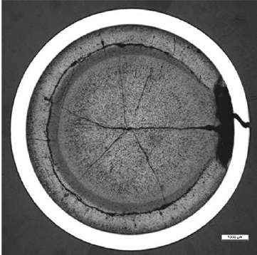
What is our geometry for the problem?
Reactor geometry depends on reactor type
The ideal geometry of each fuel rod is axisymmetric, but in reality it is 3D
Fuel pellet defects cause 3D geometry
The stacked pellets may not be stacked perfectly, causing their center axis to not be aligned, also causing 3D geometry

Slide 50
The initial condition of T
The initial condition of T is set by the state of the reactor directly before startup
What is the initial temperature profile of the fuel?
The initial temperature is uniform throughout the fuel
It is equal to the initial coolant temperature
T(x, 0) = T_{cool}(0)

Slide 51
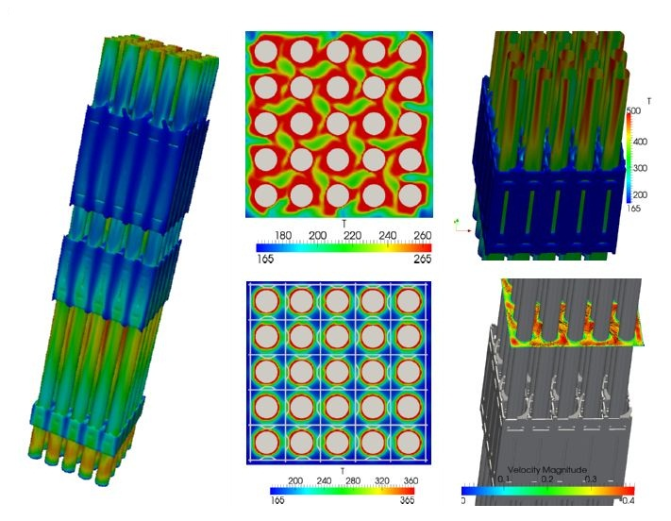
Boundary conditions?
The boundary conditions on T is set by the coolant flow
The temperature of the coolant T_{cool} is complicated
It varies along the length of the fuel rod (axially)
It various around the circumference of the fuel rod

Slide 52
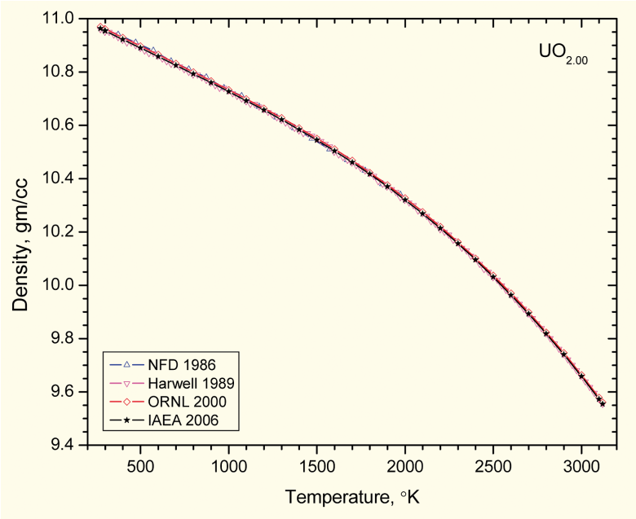
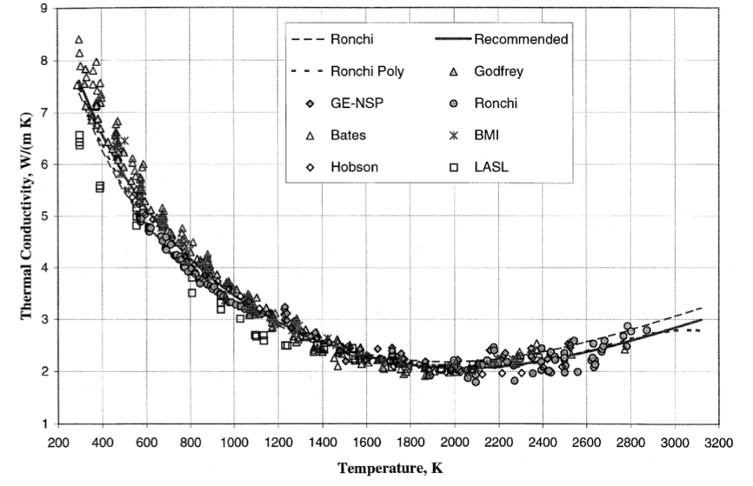
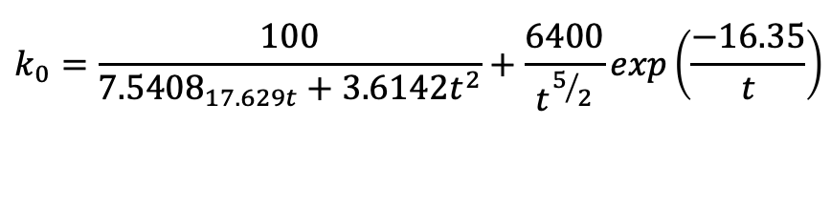
Fuel properties
Density varies as a function of T (thermal expansion)
Also varies as a function of composition (thus as a function of burnup/time)
Thermal conductivity also varies with temperature
$$k_{0}=\frac{100}{{7.5408}_{17.629t}+3.6142t^{2}}+\frac{6400}{t^{5/2}}exp\left(\frac{−16.35}{t}\right)$$

Slide 53
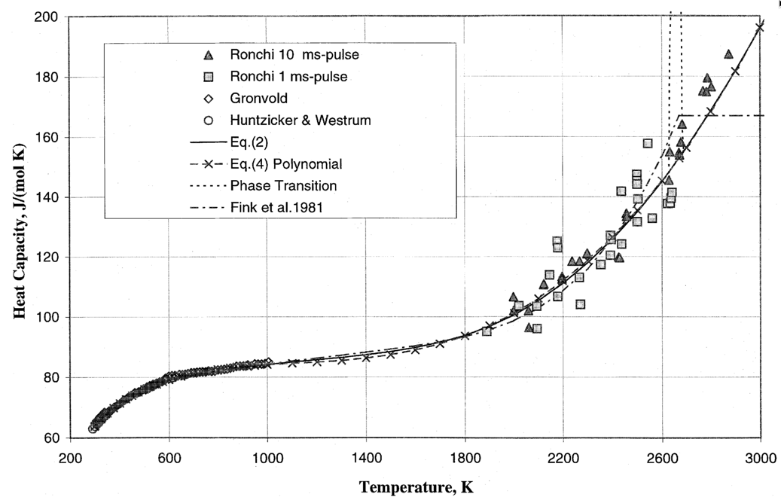
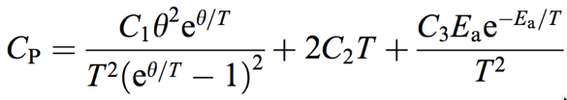
The heat capacity is a function of temperature
θ = 548.68,
C₂ = 2.285 × 10⁻³
C₃ = 2.360 × 10⁷
E_{a} = 18531.7

Slide 54
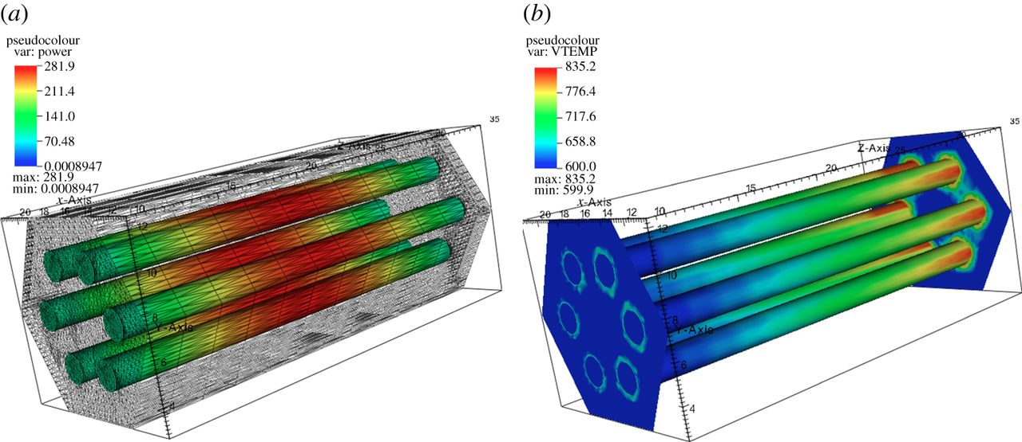
The heat generation rate is a function of the thermal neutron flux, which varies in time and space
Q = E_{f} N_{f} σ_{f} ϕ_{th}

Slide 55
Summary
General heat transport
Heat is produced in the fuel, transports through the cladding and gap, and into the coolant
The geometry of our problem
The initial condition of T
The boundary conditions of T
Is each parameter is a function of T
Thermal conductivity, heat capacity
Function of space/time?
Heat generation, dependent upon flux

